Slide 1
UNIT-IV
THERMAL PHYSICS

Slide 2
LAWS OF THERMODYNAMICS
An open system which is where energy and matter can be exchanged between a system and its surroundings.
A closed system where only energy can be exchanged between a system and its surroundings, not matter.
An isolated system where no energy or matter is exchanged between a system and its surroundings. A truly isolated system is rare.

Slide 3
The First Law of Thermodynamics:
The First Law of Thermodynamics, also known as the Law of the Conservation of Energy, says that energy cannot be created or destroyed, it can only change form. Energy comes in a variety of different forms.
Energy is not created or destroyed; it simply changes from one form to another. Turning on a light switch does not create energy, it simply converts electrical energy into radiant energy (light) and thermal energy (heat).
ΔU = Q – W + (Energy)
Here, ΔU is the total change in internal energy within a system, Q is the heat exchanged between the system and its surroundings, and W is the work done to or by the system.

Slide 4
The Second Law of Thermodynamics
The Second Law of Thermodynamics, also known as the Law of Increased Entropy, says that over time the state of disorganization or entropy in a system will always increase.
The Third Law of Thermodynamics
The Third Law of Thermodynamics says that a perfect crystalline structure at absolute zero temperatures will have zero disorder or entropy. However, if there is even the smallest hint of imperfection in this crystalline structure, then there will also be a minimal amount of entropy. Regardless, this law allows us to understand that as the entropy of a system approaches a temperature of absolute zero, the entropy present within a system decreases.

Slide 5
The Zeroth Law of Thermodynamics
It says that if two systems are in thermal equilibrium with a third system, then the first two systems are also in thermal equilibrium with one another.
If System A is in balance with System C
And System B is in balance with System C
Then System A and System B are also in balance with each other.

Slide 6
Heat transfer-Thermal expansion of solids
It is a common observation that nearly all substance expand on heating and contract on cooling. The change in temperature of a body causes expansion or contraction of that body. Most of the substances expand on heating and contract on cooling. This is called Thermal expansion.
Types of expansion
A solid substance can undergo three types of expansion, expansion in length, expansion in area and expansion in volume.
(i) Expansion in length is known as linear expansion
(ii) Expansion in area is known as superficial expansion
(iii) Expansion in volume is known as cubical expansion

Slide 7
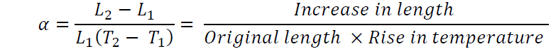
Coefficient of linear expansion of a solid
The coefficient of linear expansion of a solid is the increase in length of unit length of the solid when its temperature is raised by 1K. It is denoted by the letter
Thus if a rod having length L₁ at T₁K is heated to a temperature T₂ K its length increase to L₂

Slide 8
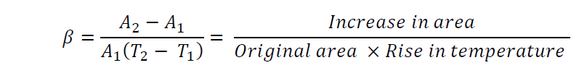
Coefficient of superficial expansion of a solid
The coefficient of superficial expansion of a solid is the increase in area produced per unit area of the solid when its temperature is raised by 1K. It is denoted by the letter
Thus if a solid having area A₁ at T₁ K is heated to a temperature T₂ K its area increase to A_{2.}

Slide 9
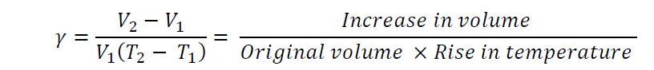
Coefficient of cubical expansion of a solid
The coefficient of cubical expansion of a solid is the increase in Volume per unit volume of the solid for 1K rise of temperature. It is denoted by the letter .
Thus if a solid having volume V₁ at T₁ K is heated to a temperature T₂ K, let V₂ volume at T₂ K. then

Slide 10
THERMAL EXPANSION OF LIQUIDS
When a liquid is heated in a container, heat flows through the container to the liquid, which means that the container expands first, due to which the level of the liquid falls. When the liquid gets heated, it expands more and beyond its original level. We cannot observe the intermediate state. We can only observe the initial and the final levels. This observed expansion of the liquid is known as the apparent expansion of the liquid. If we consider the expansion of the container also and measure the total expansion in volume of the liquid, then the expansion is termed as the absolute expansion of the liquid.

Slide 11
Absolute and apparent expansion of a liquid.
A liquid has always been taken in a container and so when heat is given to the vessel; both the liquid and the container expand in volume.
The observed expansion of the liquid is only relative to the container. If we ignore the expansion of the container what we obtain is only apparent expansion.
To find the absolute expansion of the liquid we should take into account the expansion of container.

Slide 12
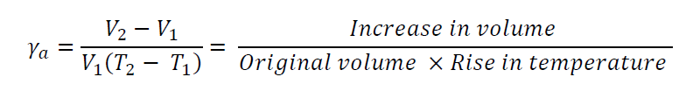
Coefficient of apparent expansion of a liquid
It is the observed increase in volume of unit volume of the liquid per degree Kelvin rise of temperature. It is denoted by
If V₁ and V₂ be the observed volumes of the liquid at temperature T₁ K and T₂ K respectively.

Slide 13
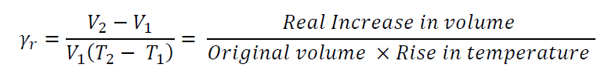
Coefficient of real or absolute expansion of a liquid
It is the real increase in volume of unit volume of a liquid per degree Kelvin rise of temperature. It is denoted by
If V₁ and V₂ be the observed volumes of the liquid at temperature T₁ K and T₂K, then
The units of coefficients of apparent and real expressions of the liquid are per oC or per K.

Slide 14
EXPANSION JOINTS
An expansion joint or movement joint is an assembly designed to safely absorb the heat induced expansion or contraction of a pipeline, duct or vessel. It is used to absorb vibration, to hold parts together.
They are commonly found between sections of buildings, bridges, sidewalks, railway tracks, and settlement of pipeline, ships and other structures.
Building forces, concrete slabs and pipelines expand and contract due to warming and cooling from seasonal variation or due to other heat sources. Before expansion joint gaps were built into these structures and they would crack under the stress induced.
We know the young‘s Modulus,

Slide 15
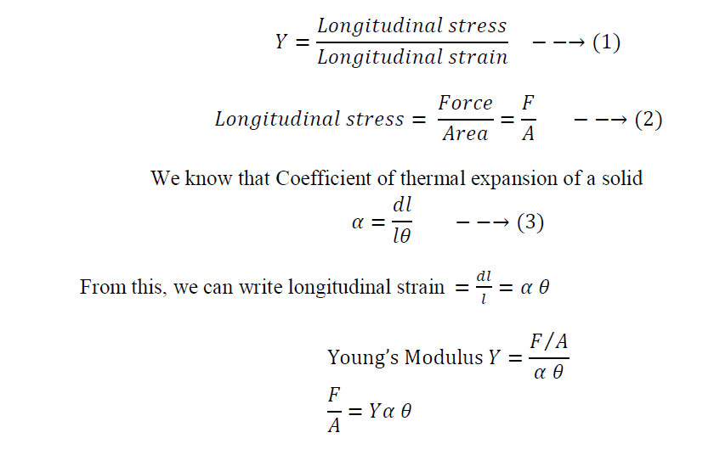
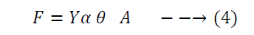

Slide 16
From equation (4) we can see that if the area is less than the force required to restore the materials to its original position is less. Suppose if the area is large then the restoring force should also be more, which is quit impossible. Hence, to avoid this problem, while constructing a large area of beams, gaps are provided & these gaps are called expansion joints.
Examples
Expansion joints are provided while lying the railway lines.
Expansion joints are provided even in the constructions of buildings. However the joints area well packed and are not visible.

Slide 17
BIMETALLIC STRIPS
  Definition
Fabrication
A Bimetallic strip means a strip made up of two thin metals pined together. These two metals have with different coefficient of thermal expansion. It is operated in the principle of different metal have different coefficients of expansion. A bimetallic strip is used to convert a temperature change into mechanical displacement. The strip consists of two strips of different metals which expand at different rates as they are heated, usually steel and copper, or in some cases steel and brass. The strips are joined together throughout their length by riveting, brazing or welding.
Let us consider two metals
Brass of higher coefficient of thermal expansion
Steel of lower coefficient of thermal expansion

Slide 18
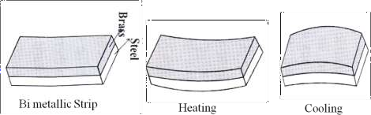
While Heating
When bimetallic strip is heated then the strip will start expanding and therefore the brass, which has large co-efficient of thermal expansion expands more than the steel and hence the bimetallic strip bends like arc as shown in figure.
While Cooling
When bimetallic strip is cooled then the strip will start contracting and therefore the brass, which has large co-efficient of thermal expansion contract more than the steel and hence the bimetallic strip bends like arc as shown in figure.

Slide 19
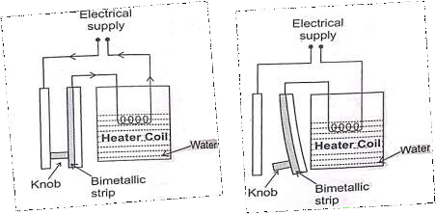
Applications
Bimetallic strips are commonly used to water heaters as temperature controller as detailed below.
A water heater connected to the bimetallic strip as shown in figure. At room temperature the bimetallic strip remains straight; the circuit is in closed condition.
When the power supply is switched on due to increase in temperature of the water, the heater coil becomes hot and in turn the bimetallic strip also becomes hot. Now due to thermal expansion, the bimetallic strip starts bending and at a particular temperature the knobs get detached and hence, the circuit becomes open. Hence the bimetallic strip acts as a temperature controller of water heater.

Slide 20
Thermal conduction
Thermal conduction is defined as the transport of energy due to random molecular motion across a temperature gradient. It is the process in which the heat is transferred from hot end to cold end without the actual movement of the particles.
Thermal conductivity refers to the ability of a given material to conduct/transfer heat. It is generally denoted by the symbol ‘k’ but can also be denoted by ‘λ’ and ‘κ’.
The reciprocal of this quantity is known as thermal resistivity. Materials with high thermal conductivity are used in heat sinks whereas materials with low values of λ are used as thermal insulators.
Thermal conductivity of materials is temperature dependent. The reciprocal of thermal conductivity is called Thermal resistivity. Metals with high thermal conductivity, e.g. copper, exhibit high electrical conductivity.

Slide 21
Convection
It is the process in which the heat is transmitted from hot end to cold end by the actual movement of the particles.
Thermal convection involves heat transfer in a convective manner. Convection involves transfer of any form of energy by the modes of transfer from one place to another, (cases which involve movement) this mainly happens in boilers, where the water nearby the furnace gets heated while the water that remains at the top won‘t receive that much heat.
Example
When some potassium permanganate is added to the beaker of water and heated. We can find that the lower region become warm first and become less dense.
Hence it moves up and the more dense cold water comes down. Now this cold water is heated and becomes less dense so that it moves towards upward direction.

Slide 22
Radiation
It is the process in which heat is transmitted from one place to another directly without the necessity of the intervening medium.
Radiation emitted by such a body due to its temperature is called thermal radiation. All bodies not only emit such radiation but also absorb it from their surroundings. If the rate of absorption and emission from a body become equal, the body is said to be in thermal equilibrium with its surroundings.
Examples
Though there is no material medium between the earth and sun, the radiation from the sun reaches us. Here the energy is sent out in the form of radiant heat waves. The properties of heat radiation are similar to light radiation.

Slide 23
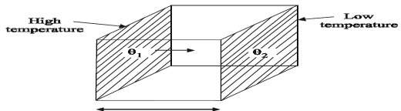
HEAT CONDUCTIONS IN SOLIDS- THERMAL CONDUCTIVITY
Different material conducts heat differently and so it is essential to know about the conducting power of materials so called thermal conducting power of a material so called thermal conductivity.

Slide 24
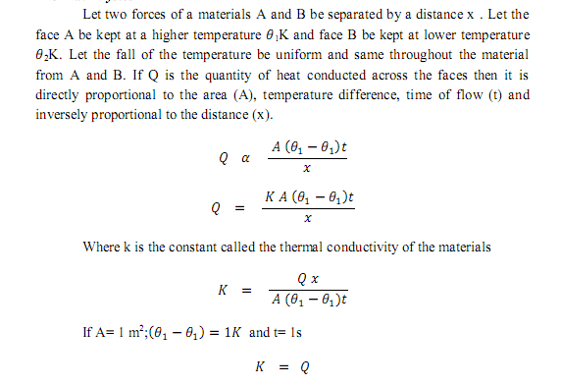

Slide 25
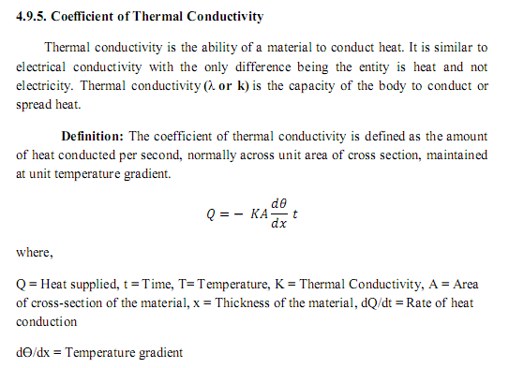

Slide 26
THERMAL INSULATION
Thermal insulation is defined as blocking of reducing heat transfer between two objects. It is also defined as thermal resistance.
It also provides a region of insulations in which thermal conduction is reduced. In other way we can say that the thermal radiation is reflected rather than absorbed by the body at lower temperature.
The insulating capacity of the material is mainly based on the thermal conductivity, insulating capacity, density and specific heat capacity of the material. Thermal insulation mainly observed in following areas.
(i).Buildings (ii) Mechanical systems (iii)Space Craft (iv) Automotive clothing etc. The following factors are mainly to be considering for providing good thermal effect, viz. (i)Thermal insulation (ii) Thermal comfort (iii) Thermal regulation (iv) Thermal resistivity

Slide 27
CLASSIFICATION OF THERMAL INSULATING MATERIALS
There are three types of thermal insulating materials, viz,
Fibrous thermal insulating materials such as felt, fur, wool and hair.
Granular thermal insulating materials such sand and sawdust.
Porous thermal insulating materials such as asbestos, aluminum foil, form rubber, cork, expended ebonite etc, all of which have a number of tiny air- pockets within them.

Slide 28
The material can also be classified into two categories based on their density.
S.No. | Less density insulating materials | High density insulating materials
1 | It has high resistive power | It has low resistive power
2 | The materials can be quickly heated and cooled | The material take more time both heating and cooling
3 | These materials will not absorb more heat | These materials will absorb enormous heat
4 | Example: cork, cardboard thermo cool etc. | Examples: Brick, stone concrete etc.

Slide 29
PROPERTIES OF THERMAL INSULATING MATERIALS
The material should be fire proof.
It should have high volumetric specific heat.
It should have low thermal conductivity.
It should be a poor absorber of moisture.
It should withstand for any environmental conditions.
It should have a fibrous granular porous structure.
It should be of low cost.
It should good looking.

Slide 30
Heat Exchangers
  Definition
  A heat exchanger is a device that is used to transfer the heat between a solid and liquid (or) between two (or) more liquid, without mixing. It is used to reduce the heat produced by a device (or) machine.
  When a fluid is used to transfer heat, the fluid could be a liquid, such as water or oil, or could be moving air. Heat exchangers are used to transfer heat from one medium to another.
  These media may be a gas, liquid, or a combination of both. The media may be separated by a solid wall to prevent mixing or may be in direct contact. Heat exchangers can improve a system‘s energy efficiency by transferring heat from systems where it is not needed to other systems where it can be usefully used.
Measurement
In a heat exchanger, the driving temperature across the heat transfer surface varies with position. Therefore the temperature difference is measured only in terms of log mean temperature difference (LMTD)

Slide 31
Mode of heat flow
The basic component of a heat exchanger can be viewed as a tube with one fluid running through it and another fluid flowing by on the outside. There are thus three heat transfer operations that need to be described,
Convective heat transfer from fluid to the inner wall of the tube,
Conductive heat transfer through the tube wall, and
Convective heat transfer from the outer tube wall to the outside fluid.

Slide 32
Heat exchangers are typically classified according to flow arrangement and type of construction. The simplest heat exchanger is one for which the hot and cold fluids move in the same or opposite directions in a concentric tube (or double-pipe) construction.
In the parallel-flow arrangement of Figures.1, the hot and cold fluids enter at the same end, flow in the same direction, and leave at the same end. In the counter flow arrangement of Figures.2, There are 3 modes by which heat is transferred from one fluid to another in all the heat exchanges, viz
(i).Parallel- flow heat exchanger
(ii).Counter –flow heat exchanger
(iii). Cross –flow heat exchanger

Slide 33
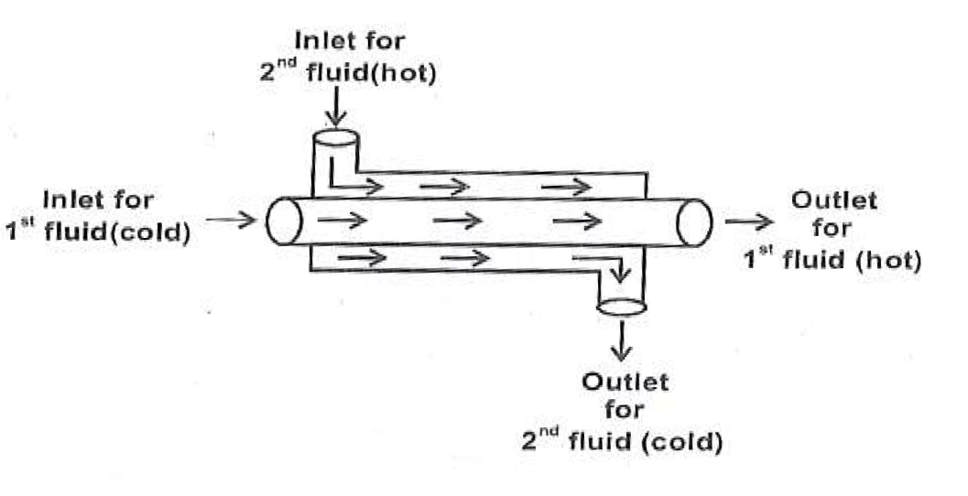
Parallel- flow Heat Exchanger
In parallel flow heat exchanger, the two fluids (one cold & other hot) enter the exchanger at the same end and travel in parallel to one another as shown in figure and reach the other end, and thereby exchange the heat.
In this type the temperature difference between the two fluids is large at the entrance end and becomes very small at the exit end.

Slide 34
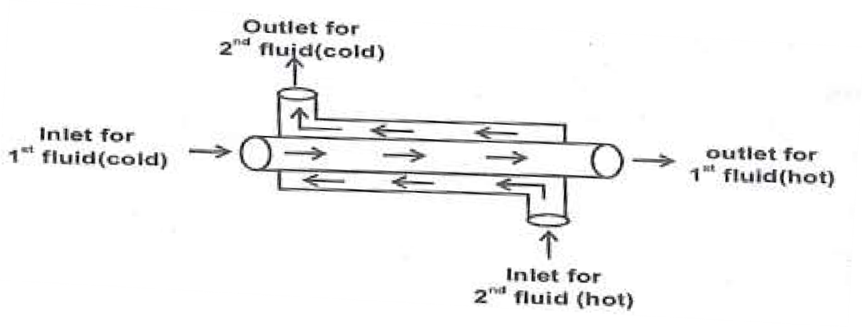
Counter –flow heat exchanger
In Counter flow heat exchanger, the two fluids (one cold & other hot) enter the exchanger at the opposite ends as shown in figure and exchange the heat between each other.
It is the most commonly used heat exchanger for liquid- liquid heat transfer and is more efficient, when compared to parallel flow heat exchanger.

Slide 35
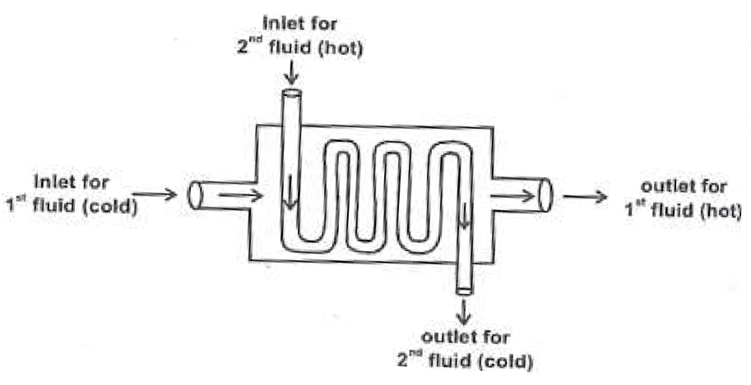
Cross –flow heat exchanger
In cross flow heat exchanger, the fluids (one cold & other hot) travel roughly perpendicular to each other, through the heat exchanger as shown in figure and exchanges the heat between them.
In this case the heat transfer take place between a liquid flowing inside a tube (or) tubes (many coils can be designed) it is mainly used in solar water heater, car radiators, refrigerators and Air conditioners.

Slide 36
Types
There are different types of heat exchangers, which are used in engineering and industries field viz.
Fluid heat exchanger.
Shell and tube heat exchanger.
Plate heat exchanger.
Plate and shell heat exchanger
Plate fin heat exchanger.
Pillow plate heat exchanger.
Direct contact heat exchanger.
Micro- channel heat exchanger etc.

Slide 37
Applications
Heat exchangers have a very wide range of applications some of them are detailed below.
They are used in refrigerators, air conditioners etc,.
Heat exchangers are often used in power plants (or) engines to cool the exhaust hot gases.
They are widely used in petroleum refineries , petro-chemical plants etc.,
They are also used in natural gas processing and sewage water treatment plants.
Heat exchanges are found in internal combustion engines, radiator coils, etc.,

Slide 38
REFRIGERATORS
Generally heat cannot flow from cold body to hot body. It is possible to do so, if some external work (or) pressure is done the working substance. This concept is used in refrigerators.
Refrigeration
Refrigeration is process of reducing and maintains the temperature of a body below the normal temperature or it is the process of removing the heat from a substance under controlled conditions.
Refrigerator
Refrigerator is an equipment used to reduce and maintaining the temperature of the body below atmospheric temperature. It is obtained by removing the heat from the space continuously.

Slide 39
Refrigerant
Refrigerant is a fluid which absorbs the heat from the body and rejects the heat at high temperature.
Examples: ammonia, carbon-di-oxide, Freon, methyl chloride, chloro Fluro carbons (CFC).
Capacity of Refrigerator (or) Refrigerating effect
It is the amount of heat extracted from the cold body per unit mass per second. It is also defined as the rate at which refrigeration produced is called the capacity of refrigerator. It is expressed in 237 tonne of refrigeration.

Slide 40
Tonnes of refrigeration
A 238 tonne of refrigeration is defined as the amount of refrigeration effect produced by uniform melting of one 238 tonne (1000Kg) of ice at 0⁰C water in 24 hours.
1tonne of refrigeration = 210 KJ/ min (or) 3.5 KJ/ Sec.
Performance coefficient
Coefficient of performance (COP) is the ratio of heat extracted and work done.
COP = heat extracted/ work done.

Slide 41
Type of refrigerators
There are two types of refrigerator,
Vapour Compression refrigerator -(Example: Domestic refrigerators)
Vapour absorption refrigerators- (Example: Commercial refrigerators)

Slide 42
Domestic Refrigerator
    Principle
The second law of the thermodynamics as given by clausius, ―without doing external work it is impossible to transfer heat from a cold body to a hot body is the principle of refrigerator.
Here the ammonia (working Substance) takes heat from the refrigerator and due to external work done on ammonia, it give heat to atmospheric air (at normal (or) high temperature ) and keep the refrigeration continuously cool.
Design
It consists of two coils viz.
Evaporator coil to convert liquid ammonia to vapour and
Condenser coil to convert vapour to liquid ammonia, as shown in figure.
The compressor in the refrigerator is used to compress the ammonia vapour using a piston to a very high pressure and helps in doing the external work on the ammonia. The whole setup is kept in well air circulation area for better performance.

Slide 43
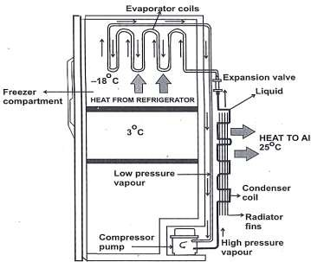
Working
In domestic refrigerator liquid ammonia is used as a working substance for
cooling the refrigerator
Here liquid ammonia at low pressure is passed the evaporator coils, wherein it expends and absorbs the heat from the refrigerator.
The liquid ammonia takes up the heat from the refrigerator and is converted into low pressure vapour.
Now the compressor is used to compress the ammonia vapour externally using a piston, to very high pressure.

Slide 44
This ammonia at high pressure is allowed to pass through for condenser coils.
While passing the ammonia vapour gives heat to the atmosphere air at room temperature and become liquid ammonia again due to cooling.
The cool liquid ammonia in turn acts as a primary refrigerant and keeps the refrigerator cool.
This cycle of processes continues and makes the refrigerator to be in cool condition always.

Slide 45
Applications
It is used for preserving the food, fruits and drinks for a long duration.
It is used to preserve flowers medicines and medical drugs.
Refrigerator is used to manufacture ice plants.
In industries they are used for processing lubricants, rubber, steel etc.,
It is used for producing frozen foods, ice creams, chemical and other products.

Slide 46
Advantages | Disadvantages
Cost of refrigerant is low | It consumes large amount of electricity
It used to store the food for a long time. | It causes global warming
It protects the food from direct sun light. | Harmful pollutant gas like CFC (Cholorofluro carbon) is used in refrigeration.
It products the food from microbes, insects and rodents. | Preserving food in refrigerator not good for health.

Slide 47
OVENS
Ovens is a cylindrical shape material made up of heavy cast-iron, which is used to roast or cook food in ancient days. In modern days ovens have become more high-tech, in which electricity is used as the source for the heating coils. More recently micro-wave oven become very popular for cooking food.
Types of Ovens
    Earth oven
    Ceramic oven
    Gas oven
    Toaster oven
    Microwave oven.

Slide 48
There are different types of ovens, based on their usage and their development from earlier Greek age to modern era. They are as follows‘
Earth oven
An earth oven is the pit dug into the found and food wrapped in leaves (or) animal skin is heated wood (or) rocks (or) debris.
Ceramic oven
The ceramic oven in constructed using clay (or) some ceramic materials with bricks and the food was cooked using firewood. It is still persisting in India and referred as tandoor.
Gas oven
In gas ovens the food was prepared either on a gas stove (or) a oven compartment in gas stoves. Usually thermostats are used in gas ovens, which are used to regulate the temperature, while cooking food.

Slide 49
Toaster oven
Toaster ovens are small electric ovens with a front door, wire rack and removable baking pan. Here bread is placed horizontally (or) vertically on the racks and was toasted by using electricity.
Microwave oven.
Microwave oven are the modern ovens which uses tiny, high powered microwaves, for cooking the food. Here the microwave directly heat the molecules in
the food particles similar to that of how sun heats our face by radiation. Let us discuss in detail about micro-wave oven.

Slide 50
Solar Water heater
Solar water heater is based on the principle of converting solar energy into electrical energy and then into heat energy, using solar electric panels, so called solar cells (or) photo voltaic cells. Nowadays, solar thermal panels were widely used, which converts the solar energy directly into heat energy.

Slide 51
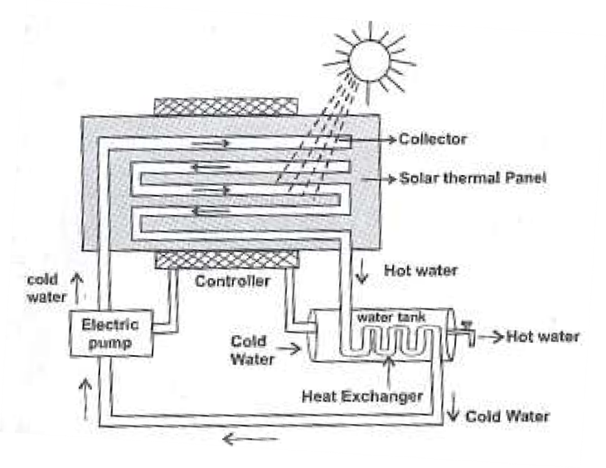
Construction
A simple roof top solar water heater is as shown in figure.
It consists of a solar thermal panel in which collector is used to collect, capture and retain the heat radiations from the sun.
The heat exchanger is made up of coil of copper pipes and is kept inside the water tank.
Heat exchanger is used to transfer that heat energy from the hot water passing through the copper pipe in the heat exchanger to the cold water in the water tank.
An electric pump is used to pump the cold water coming out from the heat exchanger to the collector of the thermal panel.
The total system is controlled by the controller unit, which is used to
Fill the water with auto cut-off in the tank.
Switch on / off the electric pump, whenever required.

Slide 52
Working
Initially, with the help of the Electric pump, cold water is pumped to the collector in the solar thermal panel.
Now due to thermal radiations that fall on the thermal panel, the water in collector is heated up.
This hot water is allowed to pass through the water tank with the help of the heat exchangers.
The heat exchanger, which is made up of coil of copper pipes, transfers the heat energy from the water inside the copper coils, to the water presents in the water tank and therefore the water in the water tank becomes ho.
The water coming out from the heat exchanger, after transferring the energy, become cold water and enters into the electric pump again as shown in figure.
Thus we can run off hot water from the tank at any time without affecting the panels operation.

Slide 53
Advantages | Disadvantages
Solar energy is free and abundant. | Capital investment and installation cost is high.
A solar thermal panel occupies less space compeered to solar photovoltaic panels. | Annual maintenance is required to check the working of pump, anti- freezing etc.
Solar thermal panels are 3 times more efficient, approximately 80% of the thermal radiation is turned into heat energy. | It occupies space and depends on the availability of direct sun light.
We can save money by paying less electricity bill. | It is not useful during rainy (or) foggy days.
It an Eco friendly way to heat water for the domestic need. | It will take about 10 to 15 years to get back the money we spent for capital investment and installation, which is based on your usage.

Slide 54
Thermal Convection
Convection is a process of heat transfer due to movement of molecules within the fluids. Convection above a hot surface occurs because hot air expands, becomes less dense, and rises (see Ideal Gas Law). Hot water is likewise less dense than cold water and rises, causing convection currents which transport energy. Convection can also lead to circulation in a liquid, as in the heating of a pot of water over a flame. Heated water expands and becomes more buoyant.
When radiation strikes a surface, a portion of it is reflected, and the rest enters the surface.
Radiative Properties
Of the portion that enters the surface, some are absorbed by the material, and the remaining radiation is transmitted through.
The ratio of reflected energy to the incident energy is called reflectivity, ρ.
Transmissivity (τ) is defined as the fraction of the incident energy that is transmitted through the object.

Slide 55
SEA BREEZES AND LAND BREEZES
Sea breezes are winds that are caused by the differential heating rates of land and sea. During the day the land heats up more rapidly than the sea because:
land has a lower specific heat than water – it requires less heat to raise the temperature of 1 kilogram of earth by 1 degree than it does for water;
the incoming heat warms a shallower layer of the land because earth is a poor conductor of heat. In water the heat is spread through a significant depth by conduction, convection and focused mixing.
Sea breezes tend to be stronger in the tropics where greater temperature differences are established between land and water and there is also a greater tendency for instability over the heated land.
Lake breezes are also formed around large areas of inland water.
Low level wind shears are often enhanced by sea breeze circulation.
Land breezes because the of reverse situation. Overnight the land cools to be colder than the sea so cold overland air moves to replace warmer the warmer air over the sea.

Slide 56
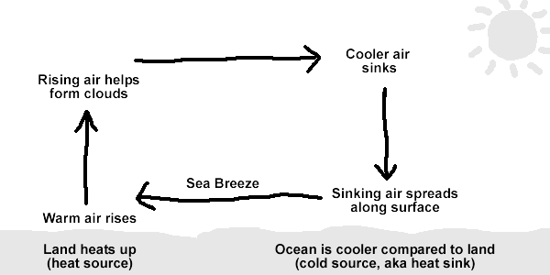

Slide 57
LAND BREEZES | SEA BREEZES
A land breeze is created when the land is cooler than the water such as at night and the surface winds have to be very light. | A sea breeze is created when the surface of the land is heated sufficiently to start air rising.
When this happens the air over the water slowly begins to rise, as the air begins to rise the air over the surface of the ocean has to be replaced, this is done by drawing the air from the land over the water, thus creating a sea breeze. | As air rises, it is replaced by air from the sea; you . Sea breezes tend to be much stronger and can produce gusty winds as the sun can heat the land to very warm temperatures, thereby creating a significant temperature contrast to the water. have now created a sea breeze.
Usually land breezes are light and reach only 5 to 8 knots. | Speeds of 10 to 20 knots is not uncommon for a sea breeze.

Slide 58
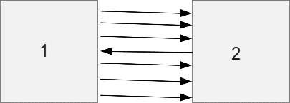
PREVOST THEORY OF HEAT EXCHANGE
Prevost suggested that all bodies radiate energy, but hotter bodies radiate more heat than colder bodies. Suppose for example that we have two bodies 1 and 2 at different temperatures T₁ and T₂ with T₁ is greater than T₂. Each body will then radiate heat to the other but since the energy radiated from 1 to 2 is greater than the energy radiated from 2 to 1.

Slide 59
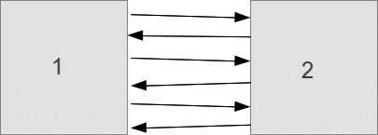
Heat will be transferred from body 1 to body 2 as long as T₁ > T₂. Eventually the bodies will be at the same temperature so T₁ = T₂ and heat will be transferred from body 1 to 2 at the same rate as from 2 to 1. The bodies will then be in thermal equilibrium.

Slide 60
According to Prevost, a body emits heat radiations at all temperatures which is independent of surroundings but the quantity of heat radiated per second depends on the temperature of the body.
The rate of radiation is greater at a higher temperature than at a lower one. At the same time, the body absorbs thermal radiation from the surrounding.
If the rate of emission by the body is less than the rate of absorption from surroundings, there is a net heat gained by the body and its temperature rises. Conversely, if the body is emitting at the rate higher than the absorption from the surroundings, there is a net loss of heat, therefore, there is a fall of temperature of the body.
The rate of emission will be greater if the temperature of the body is higher than that of the surrounding and vice-versa.

Slide 61
Heat Radiation
Radiation is a method of heat transfer that does not rely upon any contact between the heat source and the heated object.
Both conduction and convection require matter to transfer heat.
Heat can be transferred from one place to another by three methods: conduction in solids, convection of fluids (liquids or gases), and radiation through anything that will allow radiation to pass.
The method used to transfer heat is usually the one that is the most efficient.
If there is a temperature difference in a system, heat will always move from higher to lower temperatures.

Slide 62
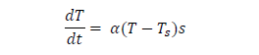
Heat Emission
Heat emission from a solid body into liquid or gas at their convective agitation is connected with thermal conductivity through the thin contact layer of the static matter adjoining at the body surface.
As the temperature gradient is proportional to temperature difference of the surface temperature and the bulk temperature of fluid or gas, the equation of heat emission has the form of Newton‘s heat emission law:
where T is the body temperature, T_{s} is the temperature of liquid or gas, α is the heat emission coefficient, and s is the area of the surface

Slide 63
Heat absorption
    Heat absorption refers to the heat transfer that occurs between two bodies; it can occur through conduction, convection or radiation. Heat absorption also is an endothermic reaction. In an endothermic process, a cooler object absorbs the hotter object‘s heat.
    Thermal emissivity
    Emissive power is the energy of thermal radiation emitted in all directions per unit time per unit area of a surface at any given temperature.

Slide 64
BLACK BODY RADIATION
A blackbody is an idealized object which absorbs and emits all frequencies. Classical physics can be used to derive an equation which describes the intensity of blackbody radiation as a function of frequency for a fixed temperature — the result is known as the Rayleigh-Jeans law.
Although the Rayleigh-Jeans law works for low frequencies, it diverges as f2; this divergence for high frequencies is called the ultraviolet catastrophe.
A perfect black body is one which absorbs and emits in all the radiations (corresponding to all wavelengths) that fall on it. The radiation given out by a perfect black body is called Black body radiation.

Slide 65
In practice a perfect black body is not available. Therefore let us consider a hollow sphere coated with lamp black on its inner surface. Now when the black body is placed in a temperature bath of fixed temperature, the heat radiations will come out only through the hole in the sphere and not through the walls of the sphere.
Therefore, we can conclude that the radiations are emitted from the inner surface of the sphere and not from the outer surface of the sphere. Thus a perfect black body is a perfect absorber and also a perfect radiator of all wavelengths.
In simple terms a blackbody is a volume which operates as a perfect absorber and emitter of thermal radiation. More specifically a blackbody is a volume which:
Absorbs all incident radiation independent of wavelength and direction.
Will emit more energy than any other surface at a given temperature.
Emits radiation independent of direction, i.e. a diffuse emitter.

Slide 66


KIRCHHOFF’S LAW
Consider an enclosure and a body is placed inside the enclosure. The radiant heat flux (q) is incident onto the body and allowed to come into temperature equilibrium. The rate of energy absorbed at equilibrium by the body must be equal to the energy emitted.
where, E is the emissive power of the body, α is absorptivity of the of the body at equilibrium temperature, and A is the area of the body. Now consider the body is replaced by a blackbody i.e. E → Eb and a= 1, the equation (1) becomes

Slide 67



Eb= q
Dividing eq. (1) by eq.(2),
At this point we may define emissivity, which is a measure of how good the body is an emitter as compared to blackbody. Thus the emissivity can be written as the ratio of the emissive power to that of a blackbody,
Ratio of emissive power to the coefficient of absorption of any given wavelength is the same for all bodies at a given temperature and is equal to the emissive power of the black body at that temperature.

Slide 68



STEFAN-BOLTZMANN LAW
According to this law the radiant energy (E) of the body is directly proportional to the fourth power of the temperature (T) of the body.
Where σ = Stefen constant, given by

Slide 69


WIEN’S DISPLACEMENT LAW
This law states that the product of then wavelength λ maximum energy and the absolute temperature (T) is a constant.
This law shows that, as the temperature increases, the wavelength corresponding to maximum energy decreases.
Wien also showed that the maximum energy (E_{max}) is directly proportional to the fifth power of the absolute temperature. E_{max} = Constant T ⁵
By deducing this law he obtained a law called Wien‘s law of distribution of energy (E_{λ}), given by
Where C₁ and C₂ are constants given by

Slide 70
NEWTON'S LAW OF COOLING
Newton's Law of Cooling states that the rate of change of the temperature of an object is proportional to the difference between its own temperature and the ambient temperature (i.e. the temperature of its surroundings).
When we apply the definition of Newton‘s Law of Cooling to an equation, we can get a formula. So, as per the law, the rate of a body cooling is in directly proportion to the difference in body‘s temperature.
We take body temperature as T and the surrounding temperature as T_{0,}
The difference in temperature stays constant at 30⁰ C. calculating the thermal energy Q. Note: the unit for thermal energy is joules. The formula derived from this equation is as follows

Slide 71

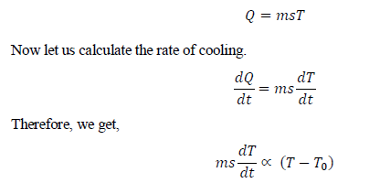
Where,
Mass of the body is represented by m,
Specific heat is represented by s And
temperature is T, Surrounding temperature is T₀
The formula for thermal energy will be as follows:

Slide 72

Because we take mass and body heat as being constant, we can write the rate of change in temperature in the following manner:
The equation gives above demonstrates that with the increase in time, the difference in the temperature of the body and its surroundings, decreases, which means, the rate of temperature will also decrease.

Slide 73
THANK YOU

